Slide 1



CASHIFY
Cashify Web and Console Features
Under the Guidance of :
Mr. Hemchand Yadav Dr. Saif Nalband
Engineering Manager Assistant Professor, CSED, TIET
(Industrial Mentor ) (Faculty Mentor)
Project Duration :
02 Jan 2025 - 02 June 2025
Submitted by :
Vartika Gautam

Slide 2


Table of Content
Introduction | 3
Background of Project | 4
Scope and Utility of the Project | 5
Architecture of the Project | 6
Sequence Diagram | 7
Technologies and Tools Used | 8
Centralised UI Testbed | 9
Professional & Technical Learning | 10
Key Highlights | 11
Video Link | 12

Slide 3



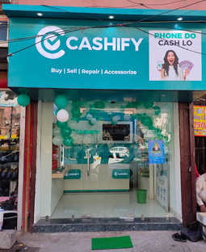
Introduction
Founded in 2013, Cashify is India’s leading re-commerce platform for buying and selling used electronic devices. Briefly tell your company's history and products.
Specializes in smartphone trade-ins, refurbishing, and resale services across B2C and B2B segments.
Partners with major OEMs and retail chains like Apple, Samsung, Chroma, and Reliance Digital.
Offers doorstep pickup, instant payments, and repair services, ensuring a smooth customer experience.
1200Cr+ Revenue as of 2025
200+ Retail Stores in more than 150 cities

Slide 4

These pods manage everything from customer-facing interactions to backend logistics, system integrations, and admin-level control panels.
Background of Project
With rapid scaling, maintaining consistency across features like KYC flows, wallet activation, incentive programs, ERP sync, and UI dashboards became critical.
My project, under the Central pod, aimed at enhancing shared modules and workflows used by multiple teams, ensuring standardized, scalable, and testable implementations.
CASHIFY PODS
Central
Sell
Buy
SCM
Digiverse

Slide 5




Centralized reusable components across pods
Scope and Utility of the Project
Streamlined KYC, wallet, and ERP workflows
Beneficial for internal teams and end users
Created a panel to override product pricing by tier, source, and pincode for better regional pricing control.

Slide 6
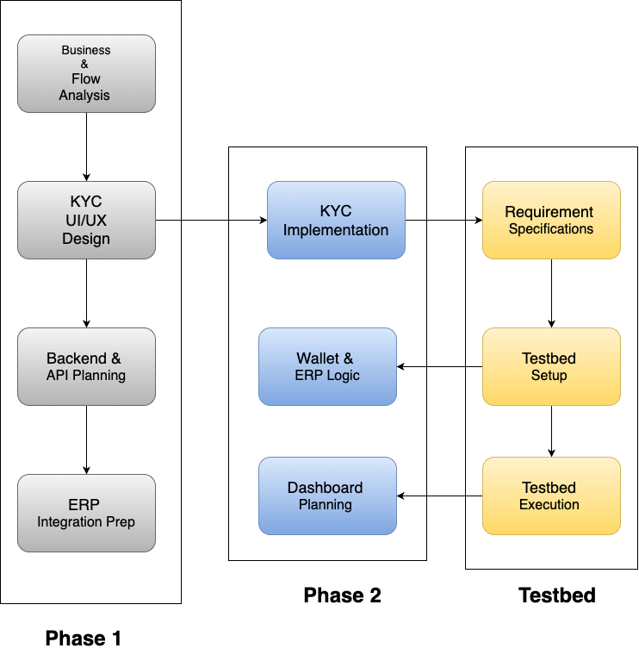
Architecture of the Project

Slide 7
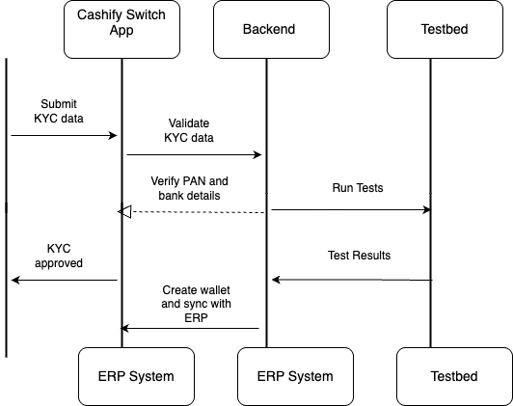
Sequence Diagram

Slide 8








Technologies and Tools Used
Frameworks
React & Nextjs
Typescript
React Native
Talwind CSS
Git
Postman
Tools
IntelliJ
JIRA

Slide 9

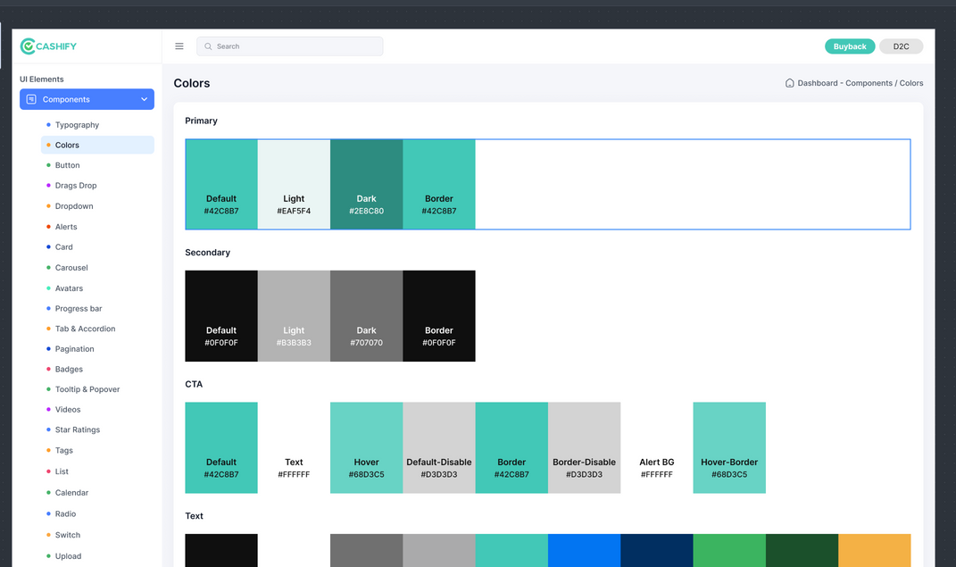
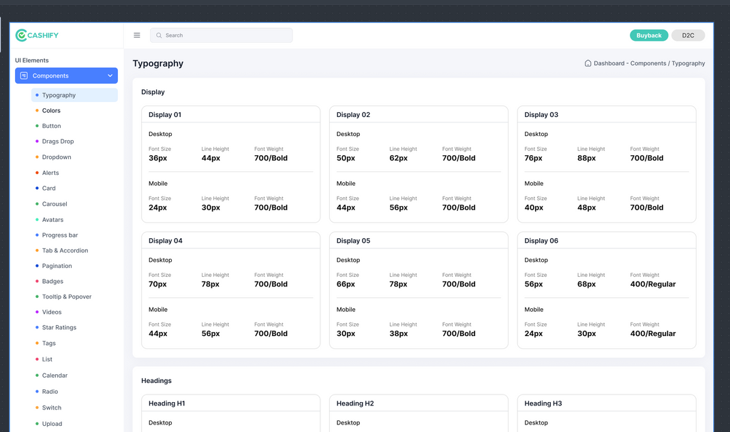
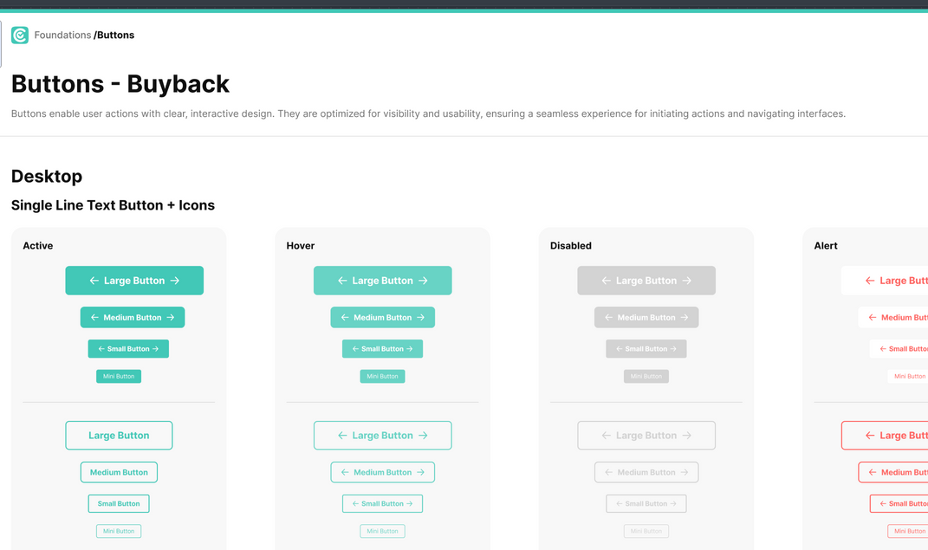
Centralised UI Testbed

Slide 10

Professional & Technical Learning
Understood agile practices like sprint planning, stand-ups, and retrospectives.
Improved communication through regular team syncs, Jira updates, and cross-team collaborations.
Learned stakeholder management by aligning tasks with business and compliance requirements.
Developed a sense of ownership and accountability through end-to-end feature delivery.
Adapted to dynamic work environments and prioritized tasks effectively.
Gained hands-on experience with React.js, Next.js, Tailwind CSS, and modern frontend architecture.
Worked on API integrations, KYC workflows, and ERP-linked financial systems.
Implemented UI consistency across pods using reusable component libraries.
Explored automated dashboard creation and data validation processes.
Strengthened debugging, version control (Git), and performance optimization skills.

Slide 11
Key Highlights
Streamlined KYC & Wallet Activation: Enabled secure user onboarding and incentive eligibility.
Integrated ERP Workflow: Ensured compliance and seamless transaction sync for redemptions.
Reusable Component System: Developed standardized UI components across multiple pods (Buy, Sell, SCM, etc.).
Dashboard for Finance Validation: Built tools for real-time monitoring and verification of redemption data.
Improved UI Consistency: Ensured cohesive design language and better user experience across the platform

Slide 12

Video Link
https://drive.google.com/file/d/1zaidBBDdodsXBI5G3eduuX0KCUSGRfNc/view?usp=drive_link

